Slide 1
Introduction Incident Management Systems (IMS)

Slide 2
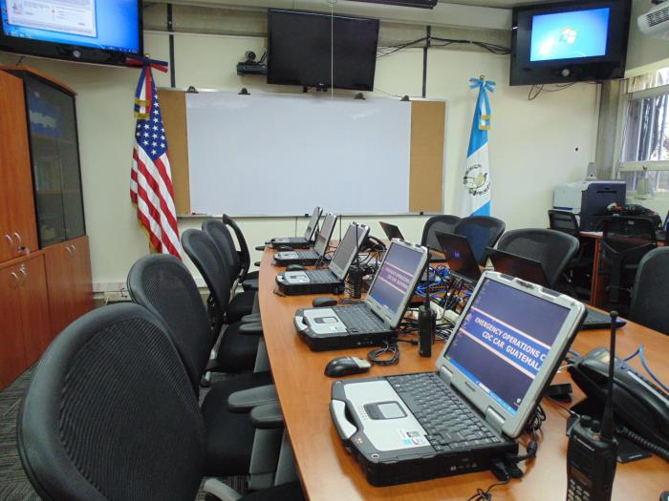
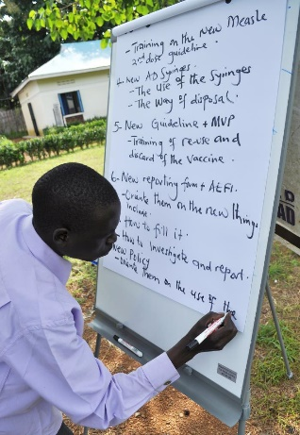

Incident Management System (IMS)
Provides the template for incident management, regardless of cause, size, location, or complexity
Applicable at all jurisdictional levels and across functional disciplines
Enables national-level, intermediate-level, and local-level governmental authorities, the private sector, and non-government organizations to work together

Slide 3
Benefits of an Incident Management System
Standardized, scalable and flexible approach
Enhanced cooperation and interoperability
Efficient resource coordination
Comprehensive all-hazards preparedness
Incorporates measurable, achievable objectives
Incidents are managed at the lowest possible geographic, organizational, and jurisdictional level

Slide 4
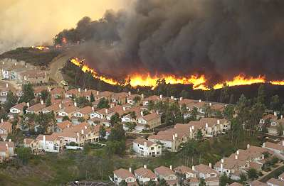
Who uses the Incident Management System?
National Departments and Agencies
Sub-national Agencies
Local Responders
Private Industry

Slide 5
When Should Public Health use the Incident Management System?
Communicable Disease Outbreaks: E. coli, West Nile Virus, Plague, SARS, Hepatitis, Hantavirus, Novel Coronavirus (COVID-19)
Non-Outbreak Situations: Flooding, disruption of utilities, mass immunization campaigns (flu, Hep A), community events, mass gatherings
Emergency Medical Services: Multi-patient and mass casualty events, trauma events

Slide 6
IMS Organizational Structure
The basic IMS structure consists of an Incident Manager (also called the Emergency Manager) and four functional sections.
This basic structure is designed to be modular: It can be scaled up and down, depending on the size, scope, and needs of the response.

Slide 7
IMS Structure – WHO Version
Very similar to the Standard IMS Structure, but with more emphasis on health and medical related resources.
Adapted from WHO’s IMS Organizational Structure, http://origin.who.int/health-cluster/about/structure/IMS_structure.pdf (Accessed 30 April, 2020)

Slide 8
Management Staff
Supervises, coordinates, and oversees:
Overall operation of the EOC
Details of the response
Response activities and partners
Situation reporting to senior leadership
Communication with the staff
Resource mobilization
Support sections
Safety of the responders
Liaison with assisting and cooperating agencies
Notes:
Supervises and coordinates the details of the IMS response
Overall operation of the EOC
Determining coordination of response activities and partners
Situation reporting to senior organizational leadership
Supervises communication with the staff
Resource mobilization
Oversees the support sections
Oversees safety of the responders
Liaison with assisting agencies (i.e. those providing their own tactical resources) and cooperating agencies (those providing external support)

Slide 9
Management Staff
Specific roles within the Management Staff can include:
Incident Manager
EOC Facility Manager
Safety Officer
Liaison Officer
Public Communication Officer

Slide 10
Incident Manager (IM)
Also called Emergency Manager, Director, or Coordinator
In charge of the entire management section and management staff
Obtains approval to activate the Incident Management System
Maintains overall situational awareness of the event and all deployed resources
Attends briefings and approves briefings to be presented
Establishes incident priorities
Approves incident objectives.

Slide 11
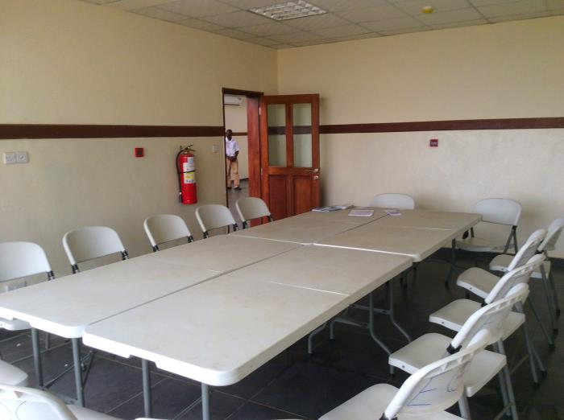

EOC Facility Manager
Oversees EOC operations and maintenance
Ensures all systems, hardware, software, and staff support tools are well-maintained and operational
May also have information technology telecommunication, geo-spatial if facility is large

Slide 12
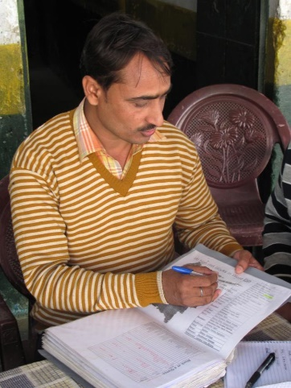

Public Communications Officer
During a public health emergency, communication with the public is vital
This person is responsible for:
Communicates and interacts with variety of audiences (ex: public, media, internal staff, etc.)
Develops communication materials and deliverables
Monitors social media and news for situational awareness
Supporting risk awareness and risk communication sectors

Slide 13
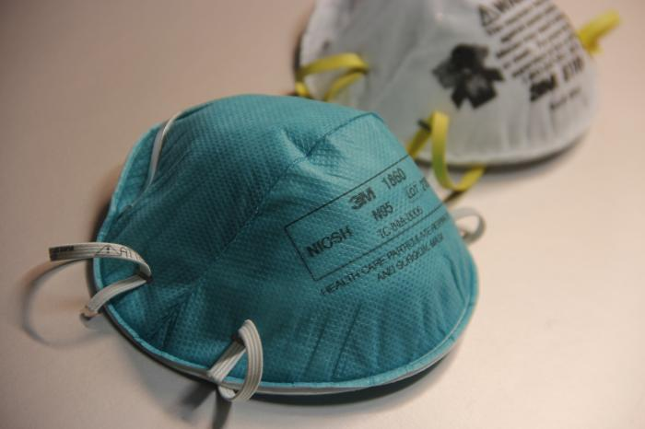
Safety Officer
The role of the safety officer is elevated during a public health emergency
Responsible for the safety and security of all personnel involved in the response, including
Authorization for access to EOC
Documentation maintenance
Appropriate safety measures
In a public health emergency, there is the added threat of exposure and illness
During COVID-19, protecting response staff from exposure and possible infection is critical

Slide 14
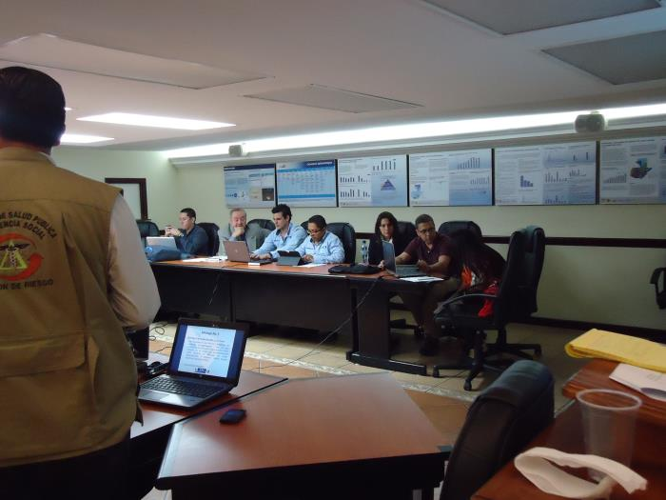
Liaison Officers
Responsible for coordination and communication between the lead agency and their partners
Their responsibilities may include:
Setting up meetings between organizations
Acting as the Point of Contact (POC) for all agency personnel
Facilitating conversations and relationships between people and organizations

Slide 15
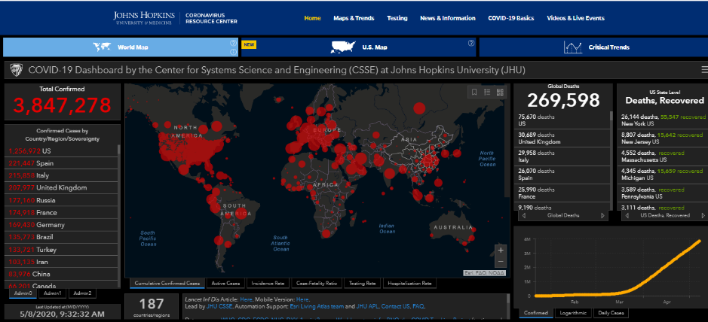
Operations Section
The Operations Section supports tactical application of resources to respond to an event
It has oversight of all direct response activities
For COVID-19, these activities might include:
Contact tracing
Case management
Risk communication
Social mobilization and outreach
Surveillance (including laboratory diagnostics)
The sub-structure of the section can be adapted according to the specific needs of the response effort
https://coronavirus.jhu.edu/map.html (Accessed May 7, 2020)

Slide 16
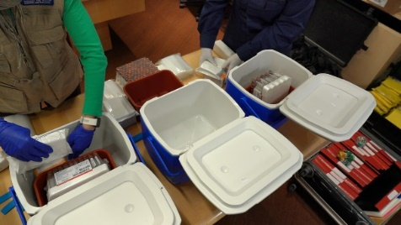
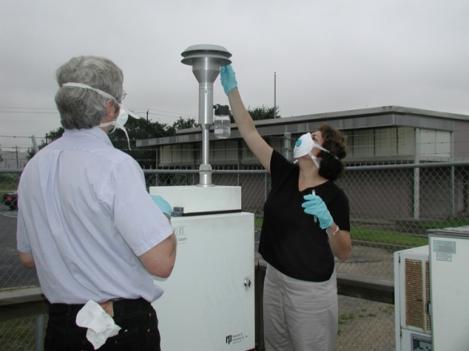
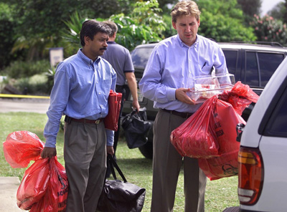
Epidemiology
Provides the capability to collect, analyze, interpret, and manage public health-related data
Supports public health surveillance and detection, as well as public health and epidemiological investigations
Identifies the source of a case or outbreak of disease, injury, or exposure and its determinants in a population
Recommends, monitors, and analyzes mitigation actions
For COVID-19, these activities might include:
Case Tracking
Contact Tracing
Surveillance (including laboratory diagnostics)
Opening and running testing Sites

Slide 17


Public Health Laboratory
Provides the capability for rapid detection, characterization, confirmatory testing, data reporting, investigative support, and laboratory networking
Address actual or potential exposures
Supports pre-event, pre-incident, and post exposure surveillance

Slide 18

Community Mitigation
Employed to slow the spread of disease and when a vaccine is not available at the outset of a pandemic
Includes social distancing strategies and recommendations to reduce contact between people:
Closing schools
Canceling public gatherings
Planning for liberal work leave policies
Teleworking strategies
Voluntary isolation of cases
Voluntary quarantine of household contacts

Slide 19
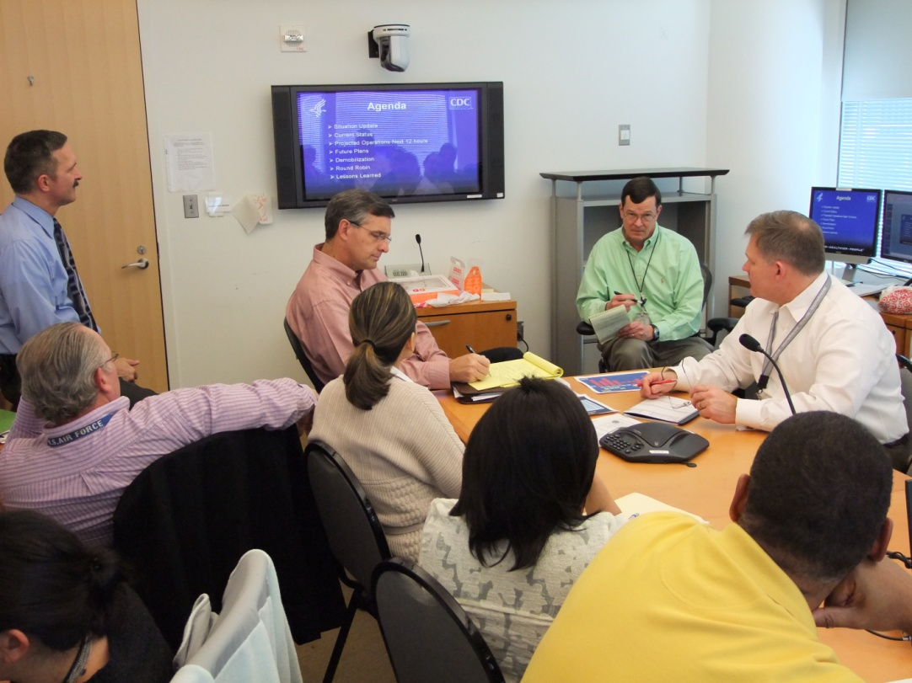
Planning Section
The Planning Section is responsible for mapping out and tasking all available resources, both human and material, to achieve maximum effectiveness.
For COVID-19, these activities might include:
Develops agency incident action plans (IAPs)
Oversight of the After Action Report (AAR) Process
Predicting and planning for future of the response
Helps develop response objectives and strategies
Identifying the technical expertise that is needed
Developing and communicating event-specific courses of action, short & long range planning, and operational information
Maintains any COVID-19 related documentation for post-response investigations, inquiries, and reviews

Slide 20
Incident Action Plans
An Incident Action Plan (IAP) is a document prepared during a response for each operational period. The purpose of the IAP is to:
Ensure response personnel are working toward the same goals by providing direction for actions to be taken during the operational period identified in the plan
Provide a coherent means of communicating the incident objectives for operational and support activities. This includes measurable strategic objectives for the operational period
Reduce freelancing and ensure a coordinated response

Slide 21
After Action Reports
An After Action Report (AAR) provides a description of what happened, why it happened, how it can be done better, and lessons learned by participants involved in a response. The report is generated from a structured discussion with participants.
An AAR:
Does not judge success or failure
Attempts to discover why things happened
Focuses directly on the tasks and goals that were to be accomplished
Encourages employees to surface important lessons in a discussion
Informs and improves our understanding of the process behind a response, as well as the strategies used before during, and after an event

Slide 22
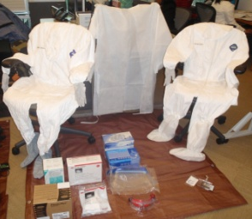
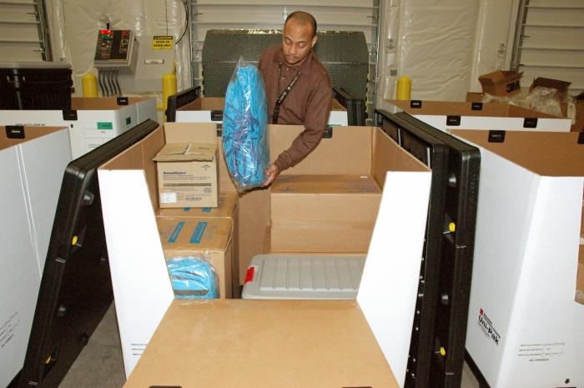
Logistics Section
The Logistics Section is responsible for obtaining, tracking, setting-up, maintaining and removing the resources required for a response.
For the COVID-19 response, this could include:
Coordination of transportation (patients , staff, and resources)
Provide deployment equipment and supplies (computers, radios, PPE, medical, labs etc.)
Provide personnel (IT, admin, medical, surge, etc.)
Facilities Services (telecommunication, desks, food / water, etc.)
Disposal (solid, liquid, and hazardous waste)

Slide 23


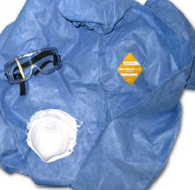

Material Management Functions
Property management and accountability
Logistics planning during emergency response
Procure and manage supplies and equipment to support emergency deployments
PPE for responders and medical staff
Masks, gloves and cleaning supplies for public facilities
Test kits, swabs, hand sanitizer, paper towels, cleaning supplies, googles, surgical gowns, Tyvek suits, etc.

Slide 24
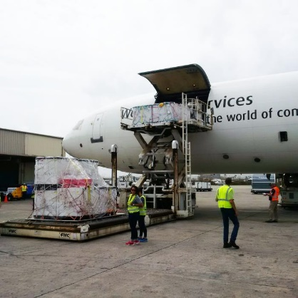
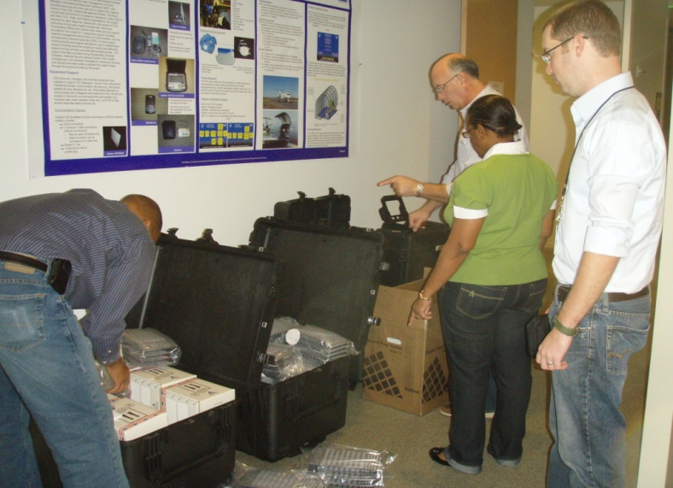
Transportation Functions
Coordinate equipment and personnel transportation
PPE, medical equipment, temporary hospitals and laboratories
Transporting patients to hospitals, quarantine, isolation, etc.
Provide emergency travel coordination 24/7/365
Coordinate and track specimens, supplies, and equipment shipments
Used test kits and swabs for analysis
Medicine, vaccines, etc.
Coordinate medical evacuation missions
Removal of vulnerable populations

Slide 25

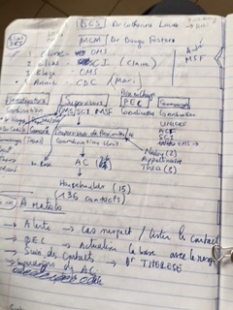
Finance and Administration Section
Tracks expenditures and human resources
Cash flow management
Surge staffing
Prepares and monitors budgets
Makes payments
Provides administrative services
Record keeping
Photo: Claire Standley (2015)

Slide 26

Surge Staffing
During a response, additional staff may be required to support functions. These “surge” staff must have appropriate training for their positions. The Finance and Administration section should:
Organize deployment briefings and trainings
Manage personnel utilization rosters
Coordinate IMS Staffing requirements and Rostering
Matching available subject matter expertise/experience with required positions

Slide 27
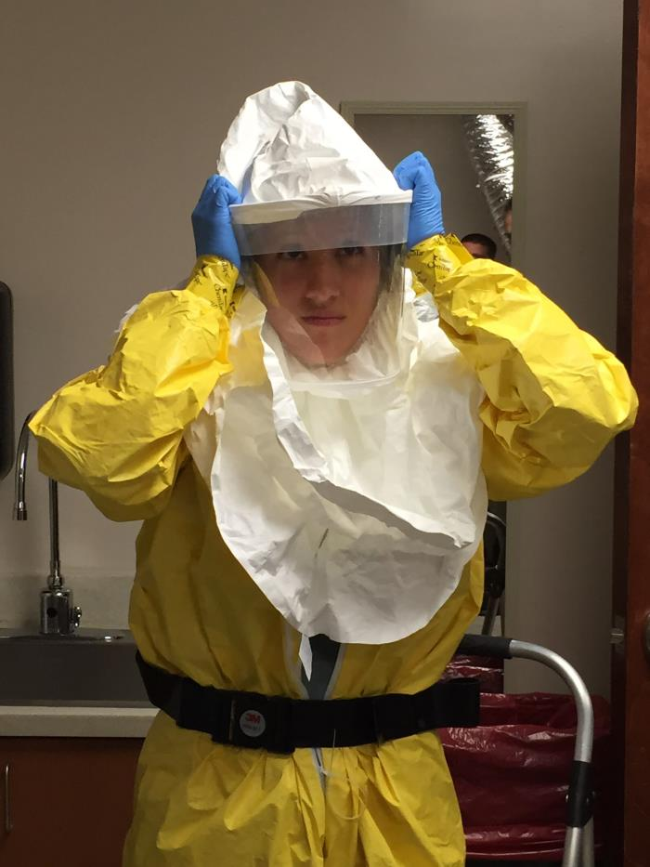
Surge Staffing
Specific roles that may require surge staff during COVID-19 response include:
Contact tracing
Social mobilization
Support and care for quarantined/isolated individuals
For COVID-19 response, additional considerations include:
Adaptation of trainings to accommodate virtual learning or appropriate physical distancing
Ensuring all surge staff and volunteers are trained in use of appropriate PPE, physical distancing requirements, etc.

Slide 28
References
WHO (2015) Framework for Public Health Emergency Operations Centres. https://www.who.int/ihr/publications/9789241565134_eng/en/
WHO (n.d.) WHO’s IMS Organizational Structure. http://origin.who.int/health-cluster/about/structure/IMS_structure.pdf
Photos retrieved from https://phil.cdc.gov unless otherwise referenced

